Slide 1
ETHICAL DECISION MAKING IN THE FIELD OF IT/CSE AND CRITICISM AND JUSTIFICATION OF ACTIONS/STANCE AS PER ETHICAL FRAMEWORKS
Md. Shahadat Anik Sheikh (2019-1-60-068)
Hasib Ar Rafiul Fahim (2019-1-60-036)
Rashik Buksh Rafsan (2018-3-60-088)

Slide 2
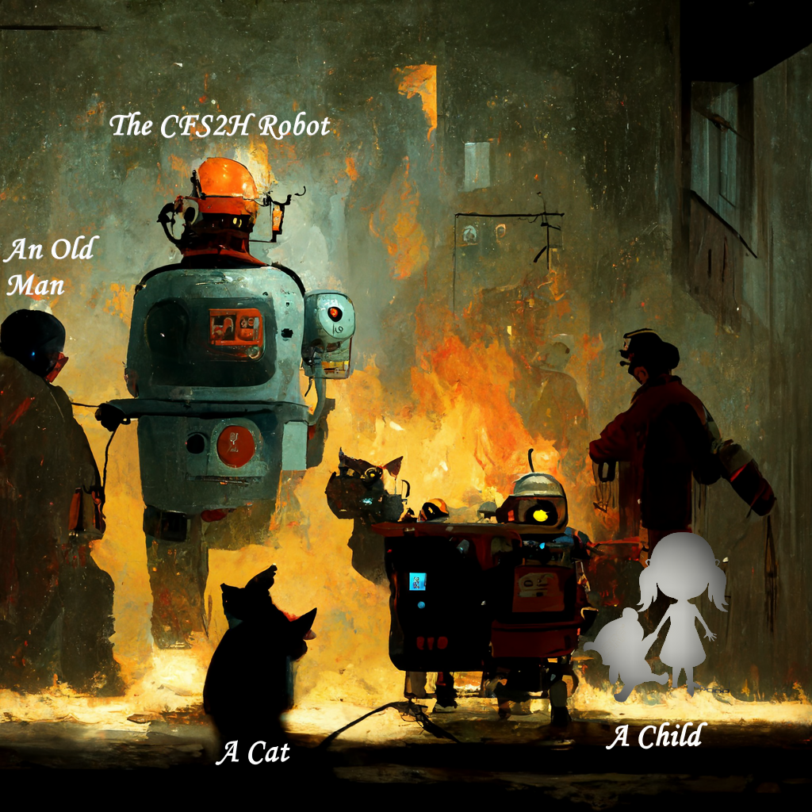
OUR SCENARIO
Fire outbreak in a house.
Rescue robot sent to rescue victims.
At first two possible victim needed to be rescued.
Suddenly a cat entered the scenario.
The robot can carry out at a time only two victims.

Slide 3
ETHICAL DILEMMA
Decision | Result
Robot picks old man and child | Cat will die
Robot picks cat and child | Old man will die
Robot picks old man and cat | Child will die
WHAT WOULD BE THE DECISION OF THE RESCUE ROBOT?

Slide 4
ANALYSIS OF EACH OF THE DECISIONS
Decision | Brainstorming | Analysis
 |  | Positive Impact | Negative Impact | Rights of stakeholders
Robot picks old man and child | Cat life risk Old man and child benefited Less emotional attachment | Old man, child and their family | Cat | Everyone has rights to live. It is their negative right. If anyone is killed, it is a violation of their negative rights.
Robot picks cat and child | Old man life risk Cat and child benefited More emotional attachment | Cat, child and their family | Old man
Robot picks old man and cat | Child life risk Old man and cat benefited Most emotional attachment | Cat, Old man and their family | Child

Slide 5
RESPONSIBILITY OF DECISION MAKER
Ultimate decision maker is the programmer.
Must act consistently in the public interest.
Be trustworthy, fair, and unable to discriminate against anyone.
Must create and put into place a system that is both reliable and secure.

Slide 6
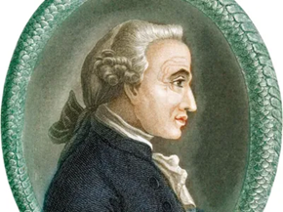
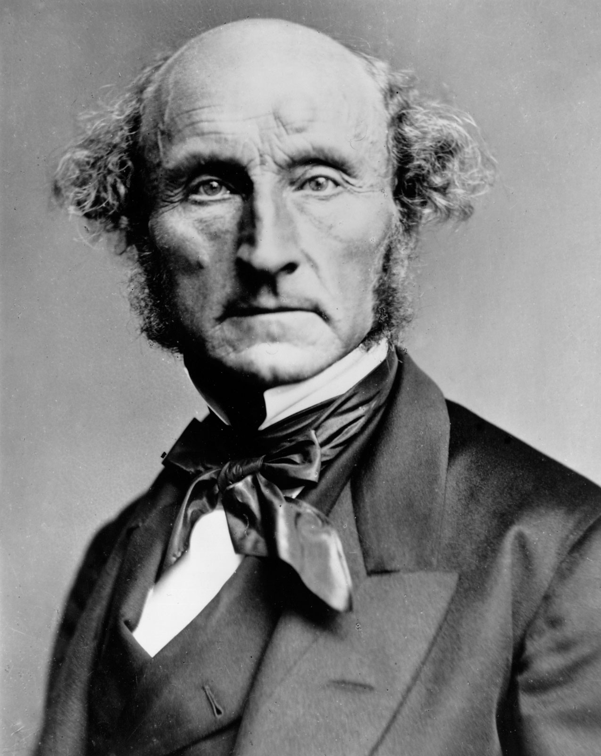
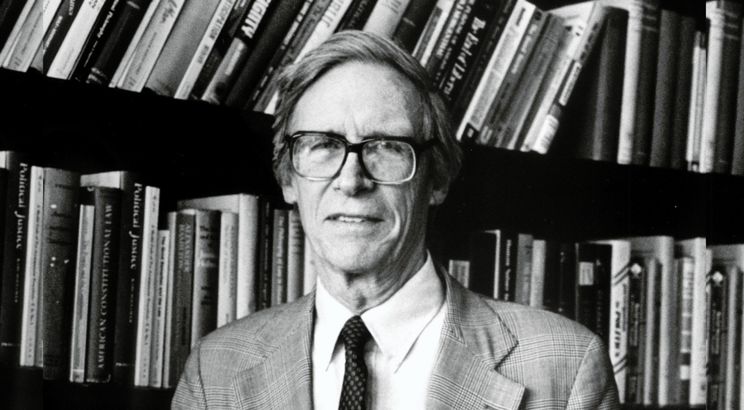
KANT’S, MILL’S, AND RAWLS’ APPROACHES
IMMANUEL KANT’S “CATEGORICAL IMPERATIVE” THEORY
MILL’S “UTILITARIAN THEORY” THEORY
JOHN RAWLS’S “THEORY OF JUSTICE”
The results or consequences of our actions which produces the greatest good for the most significant number.
According to this theory, the robot will save two human lives and left out the cat.
One should always respect the humanity of others and that one should only act following rules that could hold for everyone.
According to this theory, no decision can be made; in our scenario, at least one life will be lost.
Everyone in the society holds equal fundamental rights whether someone is from a minority group, but it does not matter.
According to this theory, the robot will save the cat, the old man and left out the child.

Slide 7
ULTIMATE DECISION
Kant’s theory is impossible in our scenario.
Theory of Justice by Rawls is not practical for our case.
By following “Utilitarian theory”, we will save two human life instead of an animal’s life which has better utility than other cases.

Slide 8
THANK YOU

